Slide 1
CRYPTOJAM A Decentralized Application for Cryptocurrency Transaction
Presenters:
Veekshith Shetty
Chaitanya Tejas
Sathwik R Gutti

Slide 2
Content
Agenda
Proposed Model.
Business Strategies.
How we Works?
How Does it Beneficial?

Slide 3
Agenda
To provide an integrated portal to the people around us to use Cryptocurrency for commerce.
To Make Cryptocurrency friendly environment in India .
To provide Safest Transaction gateway in a simplest possible way.

Slide 4
What is our Dapp Currency Model?
Our Model is a Digital Decentralized Platform (Dapp) for Online Cryptocurrency Payment System.
A Mobile Payment platform which you can send, receive Cryptocurrency and spend in online services like E-commerce, Food Delivery etc, and also in offline services.
All you need is to feed in your crypto Bank accounts or verified wallets account details.
We implement Lightning Network to achieve fast and cheap micropayments
Easy to use and Rapid Transaction.

Slide 5
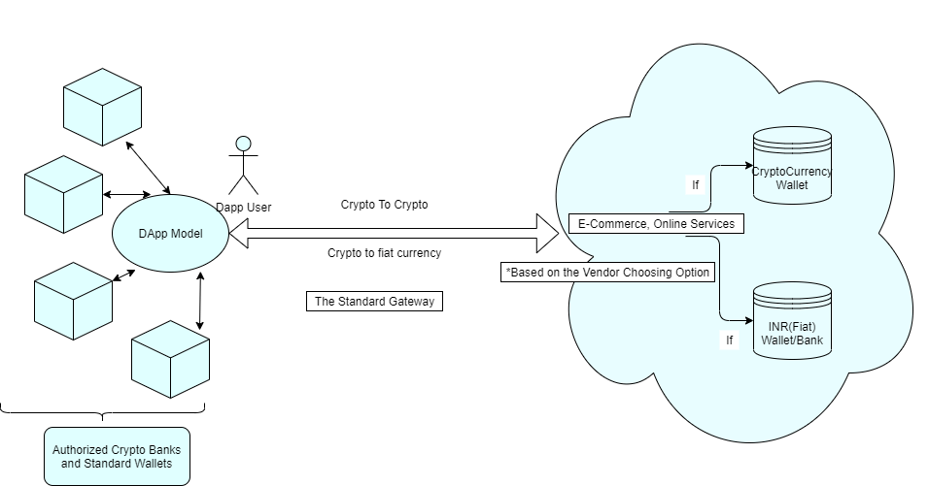
Gateway Model

Slide 6
Business Strategies
Collaborating with all popular e-commerce, Brands and Franchise
Collaborating with all authorised exchange in India to provide one gateway for Senders/Receivers from any exchange.
We offer to promote product/services, Brand Ads, and Rewards.
Helps to go Cashless and pay via cryptocurrency.
Simple and Secure online payments.
Connect with customers wherever they are with our API.

Slide 7
How we work?
Initially We offer customers to add crypto bank or standard wallet details.
We will be validating Transaction based on the KYC.
Unauthorized, delisted wallets or banks are Forbidden.
Receiver/ Vendor can receive crypto in any of their listed standard exchange wallets or Banks.

Slide 8
Business Perspective
We believe to have a strong business perspective with our product in the market.
Receiver is the person who is in benefits most of the Scenerio.
Yes, Risk factor is involved but its completely a personal choice.
E.g: If a user is willing to purchase a mobile worth 20,000INR using cryptocurrency from Flipkart.
Automatically out product will calculate crypto worth 20k and will initiate payment on user request.

Slide 9
Micropayment and Lightning Network
Blockchain micropayments are opening up new revenue streams for reviving small payments.
For Every Transaction there is high GAS cost for miners, so we can take out of chain and make it fast and reliable.
Such low-fee or no-fee transactions enable users to send and receive tiny fractions of cents.
The lightning network is a second layer technology applied to bitcoin that uses micropayments channels
The lightning network is a technological solution intended to solve the problem of transaction speed on the bitcoin blockchain by introducing off-ledger transactions.

Slide 10
Contd.
Once the payment is initiated the Receiver/Flipkart will have a option to receive it in INR/Crypto.
So question arises that how will we tackle the price variation of cryptocurrency?
We have introduced a stop loss condition in the transaction , if by any chance market price becomes low from the desired value the cryptocurrency will be automatically sold and the receiver will receive payment in INR stating no loss.
If the vendor chooses the crypto option, The received amount is considered as a default standard stop loss.

Slide 11
Contd.
If stop loss is not triggered ,the receiver will receive the payment in crypto and can even store it and take more profits due to the huge inflation.
We provide Software solution for Vendors to receive in Indian fiat currency or receive in crypto.
If the vendor chooses the crypto option, The received amount is considered as a default standard stop loss.
We can also offer them for manual set of stop loss, for their needs in form of %.
Limit orders
Transaction details are transparent, stores in the standard Ledger.

Slide 12
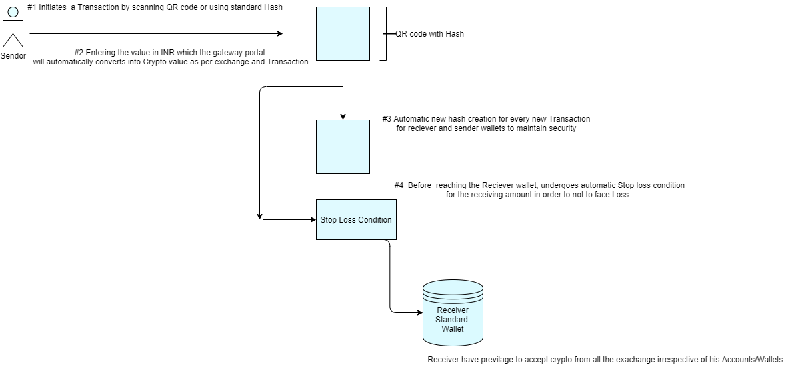
Transaction Model

Slide 13
How Does it’s Beneficial?
Our product is completely Decentralized so that every user details and Transaction are Safe and Secure.
Users can make rapid online payments, Crypto exchanges.
We maintain Ledger of user’s account which would be easy to showcase transaction proof for Government.
Attractive Rewards and Cashback in form of cryptocurrency.

Slide 14
Thankyou
Contact us:
Veekshith Shetty: 99014 02568
Chaitanya Tejas: 72599 65767
Sathwik R Gutti: 97430 00433

